Slide 1

PROJECT
A Cross-Platform Case Study of OS Telemetry Evasion and Kernel-Resident Detection on Windows 11 and Ubuntu
Can an OS be made blind to itself — and can we still catch it?
CSC I0420 — Secure Operating Systems · City College of New York · Spring 2026
Presenter: Proma Roy
Presenting to: Joseph Soryal
MITRE T1562.006
CVE-2021-21551
Three Surprises
Notes:
0:00–0:20 | 'My name is Proma Roy. I want to tell you what I tried, what stopped me, and what the data actually showed. My question was simple: can modern malware make a Windows or Linux system completely blind to itself? And if it can — can we still catch it? The answer surprised me three times.'

Slide 2



Motivation
Three real-world cases that shaped every design decision in this project.
STATE-SPONSORED APT
COMMERCIAL MALWARE
CVE-2021-21551 · CVSS 8.8
Lazarus Group
FudModule Rootkit
Remcos RAT
Dell DBUtil Driver
Privilege Escalation
North Korean state actor. Disabled EDR kernel callbacks from user space — no kernel exploit at runtime. Used BYOVD to obtain kernel access, then blinded security software without a crash.
Commercially sold tool repurposed for attacks. Applies the EtwEventWrite 0xC3 patch in memory before running its payload — makes the process invisible to any EDR tool relying on ETW.
Signed Dell driver on millions of machines. A kernel read/write flaw let Lazarus obtain Ring 0 access before deploying FudModule — the escalation step that always precedes telemetry silencing.
Technique: BYOVD kernel callback removal · 2022
Technique: In-process ETW patch · Ongoing
Local Privilege Escalation · Patch: May 2021
MITRE ATT&CK · T1562.006 · TA0005 Defense Evasion · Impair Defenses: Disable or Modify ETW / Linux Audit System
Notes:
0:20–0:45 | 'I chose this because it is already happening in real attacks. MITRE classifies it T1562.006. The Lazarus Group used it in 2022 with FudModule. Remcos RAT applies the same patch before every run. And CVE-2021-21551, a signed Dell driver flaw, is the documented path attackers use to reach the kernel before they silence the system.'

Slide 3


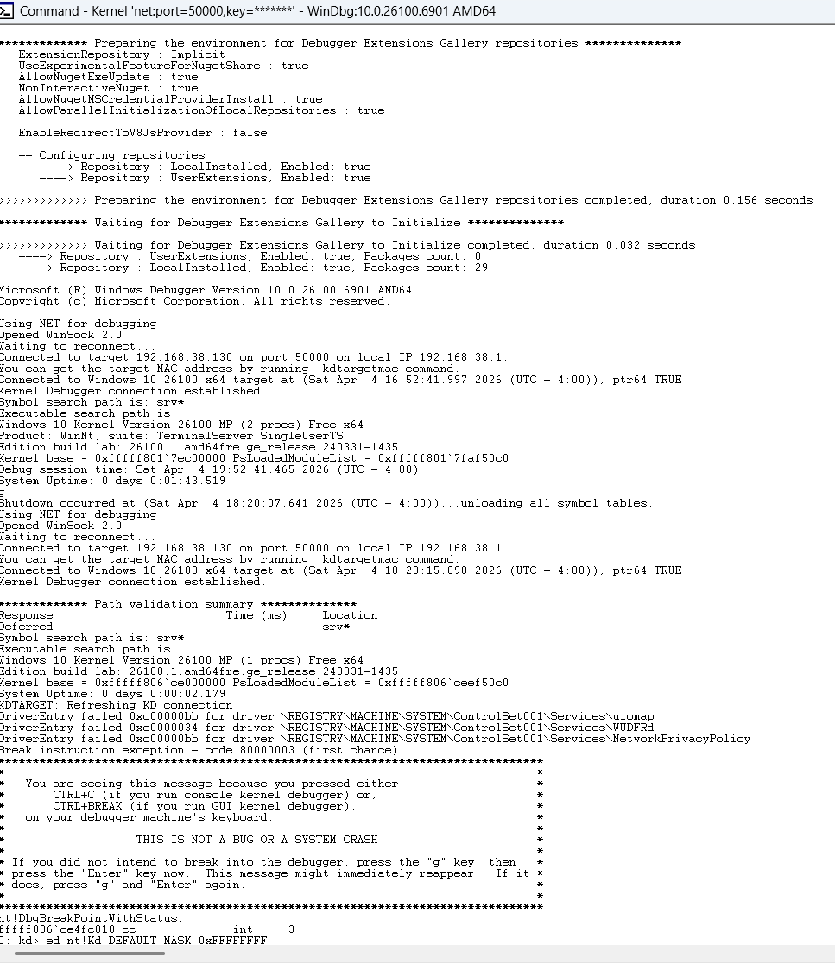
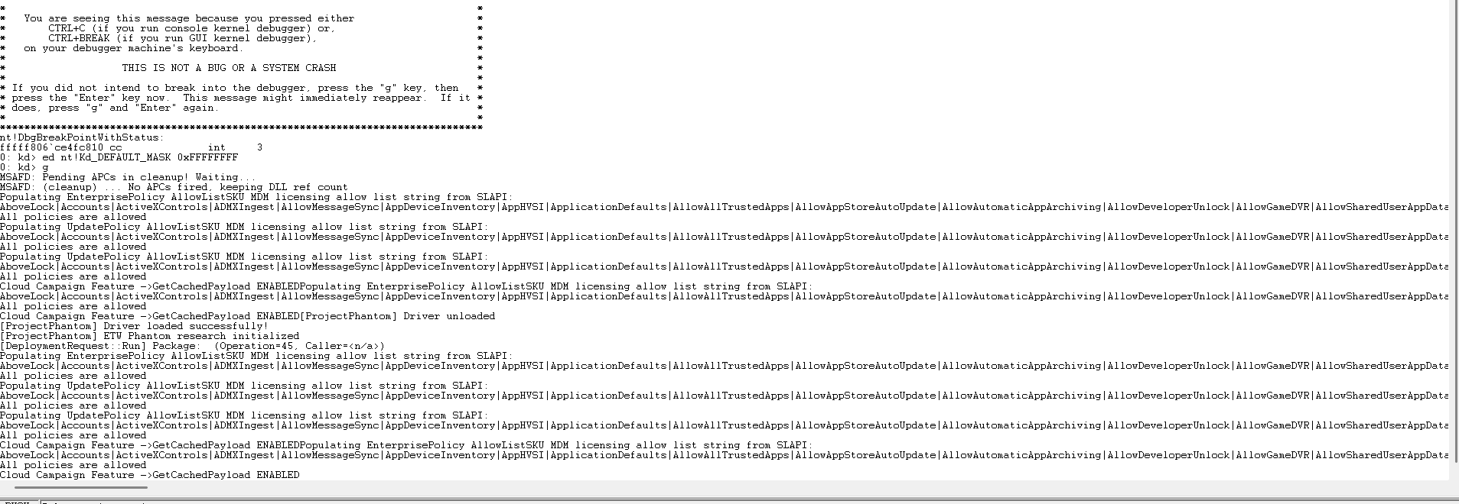

Three Environments Setup - The Windows VM, the Hardest Part
MOST DIFFICULT
Windows 11 PC
Windows 11 VM
Ubuntu 24.04 VM
Host · Development Machine
Target Machine · VMware · Test-signed kernel mode
VirtualBox · kernel 6.17 · Linux side
VS2022 + EWDK
Where PhantomGuard.sys loads · Where ETW gets patched · Where the BSODs happened
auditd monitor
Kernel driver dev environment
execve · phantom_exec tag
WinDbg
debug →
streams
→
Python scripts
phantom_guard.bt
ETW monitor + correlator
eBPF (Extended Berkeley Packet Filter) tracepoint — always on
WinDbg (host side)
auditctl -e 0
Sends debug over VMnet8
WinDbg → VM connected
Driver loaded successfully
Tamper — instant blind spot
etw_tamper.exe
PhantomGuard.sys
May 5, 2026
Compiled, deployed to VM
Kernel callback — independent stream
12:56:14 blind spot confirmed
etw_tamper.exe
0xC3 patch → ETW silenced
cross_correlator.py
2-second sliding window · compares Windows VM + Ubuntu streams · flags divergence as a JSON SIEM alert the moment they disagree
→ ALERT
Notes:
TIMING: 0:45–1:05 | ~20 sec Say: 'Three environments. My Windows 11 PC was the host — that is where I wrote and compiled everything. I had a separate Windows 11 virtual machine running as the target. That VM is where I loaded the kernel driver, ran the ETW tamper tool, and did all the actual penetration testing. Getting that VM to cooperate was the most painful and frustrating part of the entire project — the WinDbg connection kept failing, the driver refused to load, and when it finally did, it crashed the system. The Ubuntu VM on VirtualBox was the Linux side. Each environment had a specific role, and all three had to work together.'

Slide 4
What Was Actually Built - Windows + Linux
Windows 11 — Six Phases
Ubuntu VM — Linux Extension
01
Hello World Kernel Driver
audit_monitor.py v5
Confirmed VS2022 + EWDK + WinDbg over VMnet8 — toolchain proven before anything else.
tail -f on /var/log/audit/audit.log
phantom_guard.bt
02
Python ETW Baseline Monitor
bpftrace eBPF · execve tracepoint
Microsoft-Windows-Kernel-Process provider, JSON log per process creation event.
Tamper: auditctl -e 0
03
C++ ETW Tamper Tool (etw_tamper.cpp)
Root cmd · instant system-wide silence
0xC3 RET patch at EtwEventWrite byte zero in ntdll.dll — ETW silenced in the target process.
Live demo
12:56:14, May 5, blind spot confirmed in real time
04
PhantomGuard.sys Kernel Driver
PsSetCreateProcessNotifyRoutineEx — independent stream the patch cannot reach.
Tools
05
Python Cross-Correlator
C++ · Visual Studio 2022 Community
2-second sliding window, phantom_alerts.json, T1562.006 attribution in every alert.
WDK 11 · EWDK · WinDbg Preview
06
A Test Evaluation Suite
Python 3.11 · pywin32
Automated test runner + timing side-channel analysis across tampered and clean runs.
bpftrace · eBPF · auditd
VirtualBox · VMware (debug target)
Notes:
TIMING: 1:05–1:35 | ~30 sec Walk through phases 1–6 in one phrase each. Do not go into code details here. Then: 'On Linux I replicated the same structure — auditd for the primary stream, a bpftrace eBPF program hooked directly to the execve syscall tracepoint as the independent view. The live demo ran on May 5th, 2026 and confirmed the blind spot.' Then name the tools briefly. Do NOT linger here. Keep moving.

Slide 5
CASE
Observation #1 - Windows Fought Back
01
The Attack
Why Windows Could Resist
01
Located EtwEventWrite in ntdll.dll
RING 0 — KERNEL
The function Windows uses to send every security event into the ETW pipeline
ETW dispatch table lives here
Lazarus Group FudModule operates here
Requires signed driver + Microsoft authorization
02
Changed one byte in memory
BEFORE
AFTER
0x40 PUSH rax
→
0xC3 RET
PROTECTED BOUNDARY — Cannot be crossed from Ring 3
RING 3 — USER MODE
03
Expected: complete silence
Where I operated
ntdll.dll patch applied here
Windows detected it and returned 0x27
ETW stream goes dark — no events logged from affected process
!
Got: Error 0x00000027 (ERROR_NOT_READY)
Undocumented internal ETW integrity check — never seen in any public reference
First surprise:
Windows 11 is actively defending its telemetry pipeline in ways that are not publicly documented. The 0x27 response appeared on every tampered run — consistently, reproducibly.
Notes:
0:45–1:25 | 'I built a tamper tool that found EtwEventWrite — the function Windows uses to log every security event. Think of it as the wire connecting the security cameras to the recording room. I changed one byte. 0x40 became 0xC3 — a RET instruction that makes the function return immediately without logging anything. I expected silence. Instead Windows returned error code 0x00000027 — a code I had never seen in any documentation. After research I found it is an internal integrity check. The OS detected that its own logging function had been tampered with. The reason it could fight back: I was operating at Ring 3, user mode, where normal applications run. To fully blind ETW the way Lazarus Group does, you need Ring 0 — kernel level. That boundary exists specifically to stop what I was trying to do. First surprise: Windows 11 is actively defending itself in ways that are not publicly documented.'

Slide 6

CASE
Observation #2 - The BSOD
02
Windows 11 PC
Windows 11 VM
Ubuntu 24.04 VM
MOST DIFFICULT
Host · Dev machine
TARGET · Most painful
Linux side · VirtualBox
VS2022 + EWDK
Driver loaded here
auditd monitor
WinDbg (sends debug to VM)
ETW patched here
phantom_guard.bt (eBPF)
Python scripts run here
BSODs happened here
Linux extension
The BSOD — DRIVER_IRQL_NOT_LESS_OR_EQUAL
After fix — PhantomGuard working
Cause: wrong callback signature
Captures every process on the system
Completely independent of ETW
Unaffected by the 0xC3 patch
PsSetCreateProcessNotifyRoutine
vs
PsSetCreateProcessNotifyRoutineEx
One mismatched parameter type. No warning. No error message. The entire OS goes down.
Driver loaded successfully
Second surprise:
The most important lesson in kernel development is not how to write the code. It is how to survive getting it wrong.
WinDbg → VM connected
Notes:
1:25–1:55 | 'So I went deeper. I wrote PhantomGuard — a kernel driver that registers directly with the Windows kernel to monitor every process, completely independent of ETW. I ran this on a separate Windows 11 virtual machine, which became the most painful part of this whole project. Three environments: my host PC for development, the Windows VM as the actual target, and the Ubuntu VM for Linux. Getting the Windows VM working took four days. The first time I loaded the driver it crashed the entire system. Blue screen. A DoubleFault. Cause: one wrong function pointer type. In kernel development there is no warning and no second chance. I fixed the callback signature, reloaded it. This time PhantomGuard captured every process on the system — completely independent of ETW, completely unaffected by my attack. Second surprise: the most important lesson in kernel development is not how to write the code. It is how to survive getting it wrong.'

Slide 7
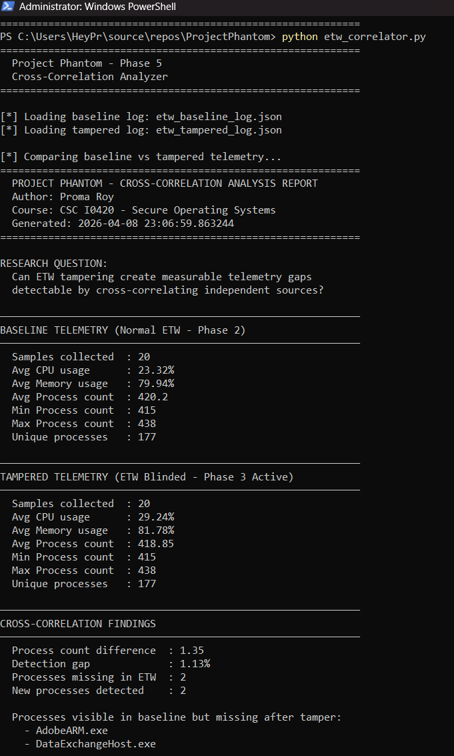
CASE
Observation #3 — The Inverse Timing
03
Cross-Correlation Results
The Timing Finding
1.13%
0
Expected
Tampering → more chaos → ↑ jitter
Scheduling becomes unstable, irregular
detection gap
false positives (50 tests)
Ghost Processes — ETW-invisible without tampering
vs
AdobeARM.exe · DataExchangeHost.exe
Actual
Tampering → less work → ↓ jitter
0xC3 skips all logging — fewer cycles used, tighter scheduling
Third surprise:
Blinding the OS made it more efficient. That efficiency change is a timing signature — detectable from user space without any kernel privileges at all.
A new detection path nobody else has documented.
Actual cross-correlator output · April 8, 2026
Notes:
1:55–2:25 | 'When I ran the full cross-correlation — ETW blinded, kernel driver running, Python correlator comparing both streams — I found a 1.13% detection gap. Two processes disappeared from ETW that the kernel driver still saw: AdobeARM.exe and DataExchangeHost.exe. The attack worked — but only partially. Then the timing analysis showed something I completely did not expect. I measured scheduling jitter during normal operation versus during tampering. I expected tampering to make the system chaotic — more noise, less consistency. The opposite happened. Jitter decreased during tampering. The system became more consistent, because patching EtwEventWrite with a RET instruction meant the kernel was skipping all the logging work — less work per cycle, tighter scheduling. Third surprise: blinding the OS made it more efficient. And that efficiency change is itself detectable — a timing signature measurable without any kernel privileges at all.'

Slide 8
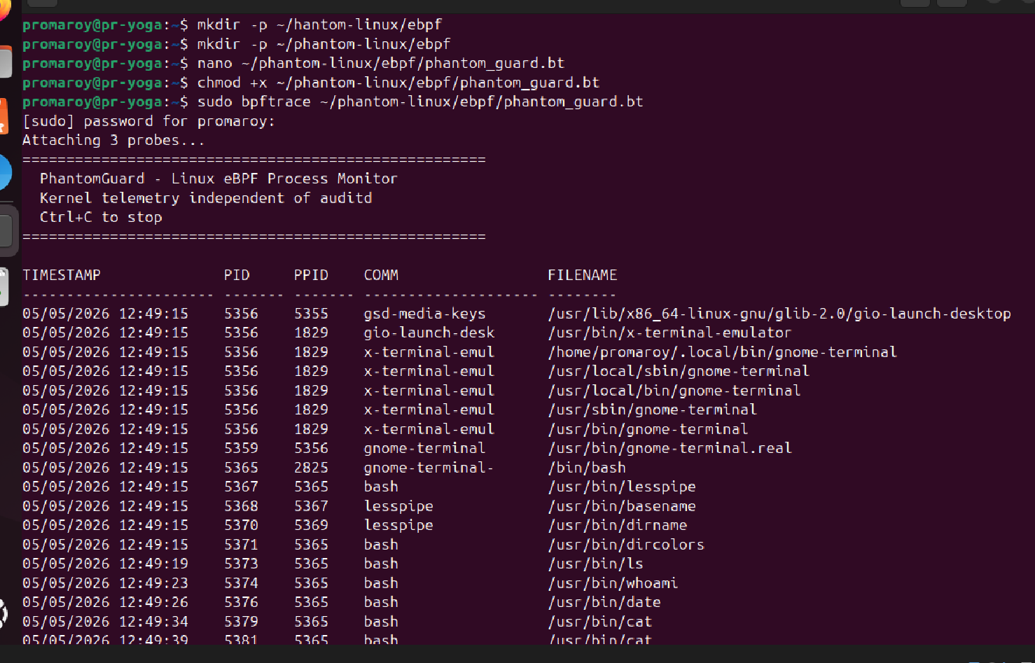
What I Proved — Windows and Linux
Windows — Partial Blind
Linux — Total Blind
1.13% detection gap
auditctl -e 0 → Total silence
2 processes hidden from ETW at Ring 3
Not 1.13%. Every audit record stopped instantly, system-wide
Ring 3 limitation
Could not achieve full blind from user mode
ETW integrity check
0x27 error — OS detected the tamper attempt
Kernel sensor: 100%
phantom_guard.bt — eBPF output · May 5, 2026
PhantomGuard saw everything ETW missed
Blind spot: 12:56:14 → 12:58:52 = 2 min 38 sec
12/12 tests passed · 0 false positives across 50 benign launches
eBPF: 100% CAPTURE THROUGH ENTIRE BLIND SPOT
Different OS. Different kernel. Same architectural result: the independent kernel sensor saw everything the primary stream missed.
Notes:
2:25–2:45 | 'I then replicated the same architecture on Linux. On Linux the attack is cleaner — one root command, auditctl -e 0, silences auditd completely. Not 1.13%. Total silence. I confirmed this live on May 5th at 12:56:14. But the eBPF monitor hooked directly to the kernel tracepoint kept capturing every single process through the entire two minute thirty-eight second blind spot without interruption. Different OS, different kernel — same architectural result. The independent kernel-level sensor saw everything the primary stream missed on both platforms.'

Slide 9


What I Couldn't Do - and Future Work
The Honest Result — Windows
What's Next — macOS (Summer 2026)
Could not achieve full blind from Ring 3
Attempted briefly during this project. Hit a wall immediately — macOS uses the Endpoint Security framework, SIP, and strict codesigning. It is a completely different research problem that cannot be approached the same way as Windows or Linux.
1.13% gap — not 100%. The Ring 3 / Ring 0 boundary held.
What a full blind requires
Planned: Endpoint Security API · macOS eBPF equivalent
Dedicated project — not an afterthought
Signed kernel driver with Ring 0 access
Microsoft EV code signing authorization
ETW internal dispatch table manipulation
→ Exactly what Lazarus Group has. I don't.
Full Code GitHub
The gap between 1.13% and 100%
is exactly where the most interesting security research lives.
PhantomGuard.sys · etw_tamper.cpp
cross_correlator.py · 12-test suite
audit_monitor.py · phantom_guard.bt
https://github.com/HeyPromaRoy/Secure-Operating-system.git
Notes:
2:45–3:00 | 'The honest result: on Windows I could not achieve a full blind from Ring 3. 1.13% not 100%. To blind ETW globally the way Lazarus Group does, you need a signed kernel driver with Ring 0 access and Microsoft authorization. That boundary held. The next gap is macOS. I poked at it briefly — hit a wall immediately. The Endpoint Security framework and SIP make it a completely different research problem. That is summer 2026. Full code and report — scan the QR code. Thank you.' — STOP. Nothing after thank you.

